Slide 1
Lecture 37
Dec. 13th , 2019
Exam 4 next Friday—Dec. 13th. I have decided to incorporate exam 4 material into the final exam. ~30% new material/~70% cumulative
Final exam Thursday, Dec. 19th, 8-10 am. Approximately 30% of the questions will cover the new material from lectures ~30-37—DNA chemistry, structure, replication. Genetic mechanisms transcription and translation and mutations.

Slide 2
Look for an email and website update with more detail on the format of the Final exam---Tomorrow or Sunday.

Slide 3
Where were we?
Transcription—Mechanism. How is it done?
Structure of a gene. Role of the regulatory sequences and transcription factors
mRNA—prokaryotes
mRNA –eukaryotes—modifications that occur before translation

Slide 4
Animations
http://highered.mheducation.com/sites/0072943696/student_view0/chapter3/animation__mrna_synthesis__transcription___quiz_2_.html
http://www.dnalc.org/view/15510-Transcription-DNA-codes-for-messenger-RNA-mRNA-3D-animation-with-basic-narration-.html

Slide 5
How is mRNA translated into protein
Code= nucleotide sequence of mRNA
Product= amino acid sequence
Work during the 1950s and 1960s by Sydney Brenner (died only in the last year!) and Francis Crick cracked the code.

Slide 6
The code—Translation
Be familiar with the list of 9 items to describe the code. Text p. 316
  Brenner agued theoretically that the code must be at least 3 nucleotides to cover all 20 amino acids.

Slide 9
The code…
Code in the mRNA nucleotide sequence is called the codon
Code is read 5’---3’ in the mRNA
The code is unambiguous! Each codon specifies one and only one amino acid. (e.g. UUU in mRNA specifies Phenylalanine only. UUU never specifies leucine…)

Slide 10
Continued…
With 64 combinations of nucleotides in codons, and only 20 amino acids, most amino acids have more than one codon ( e.g. phenlalanine is encoded by UUU AND UUC)
Thus the code is thus said to be degenerate or redundant.

Slide 11
Some codons serve as special signals in translation
  Start codon =AUG (proteins are always started by Methionein. )
  UAA UAG UGA = Stop codons. They do not specify any of the 20 AA so translations halts when ribosomes encounter one of the stop codons.

Slide 12
Continued…
The mRNA code (in mature—intro-less mRNA) is “commaless”. Translation proceeds from the start codon through the stop codon.
  This region of the mRNA is called an Open Reading Frame (ORF)

Slide 13
Continued…
The code is (nearly)universal!!
  Have you observed this personally? Have you seen that a gene from one organisms is translated the same way (into the same protein with the same function) in a different organism?

Slide 14
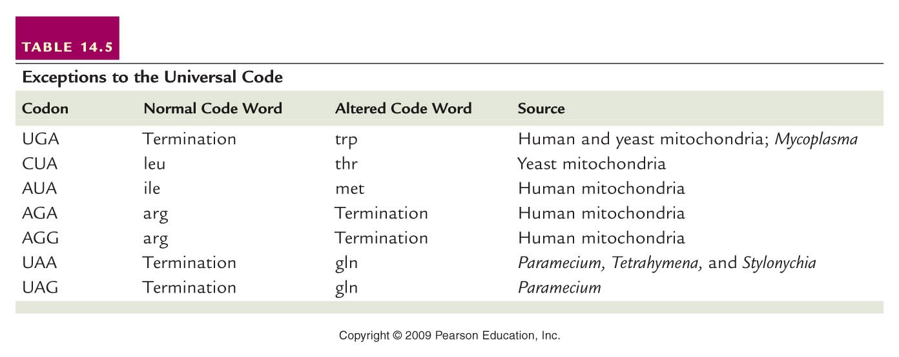
Only a few exceptions to the universality of the code.
Table 14.5
Notes:
14
Table 14-5 Exceptions to the Universal Code

Slide 15
How is mRNA translated into protein?
Code= 3- nucleotide sequence (codons) in mRNA
Product= amino acid sequence of protein
Ribosomes provide meeting space for mRNA, and special helper RNAs called tRNAs, which are attached to amino acids.
Complementary base pairs match one tRNA to one mRNA codon

Slide 17
The basics of translation/protein synthesis
An adaptor molecule, tRNA, with a sequence complementary to the mRNA codon, forms temporary hydrogen bonds with the codon. (the part of the tRNA that binds he codon is called the anticodon.)
Each tRNA will have an amino acid that corresponds to the codon it can bind to:
Look at your genetic code---what anticodon sequence will the tRNA that carries methionine (Met) have.

Slide 18
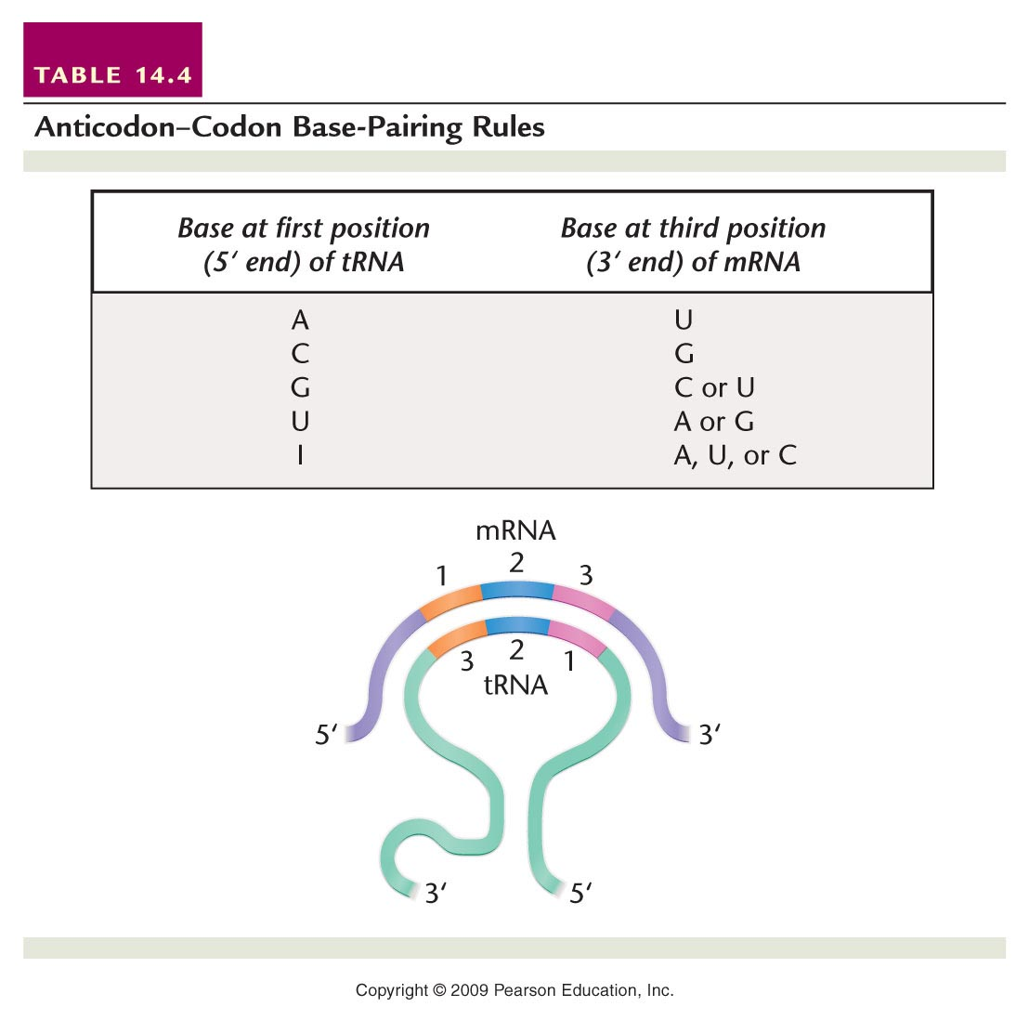
Codon
anticodon
Amino acid
Table 14.4
Notes:
18
Table 14-4 Anticodon–Codon Base-Pairing Rules

Slide 19
Test yourself by predicting another tRNA anticodon. Pay attention to the 5’-3’ orientation.
U U U
A A A
Phenylalanine
Table 14.4
Notes:
19
Table 14-4 Anticodon–Codon Base-Pairing Rules

Slide 20
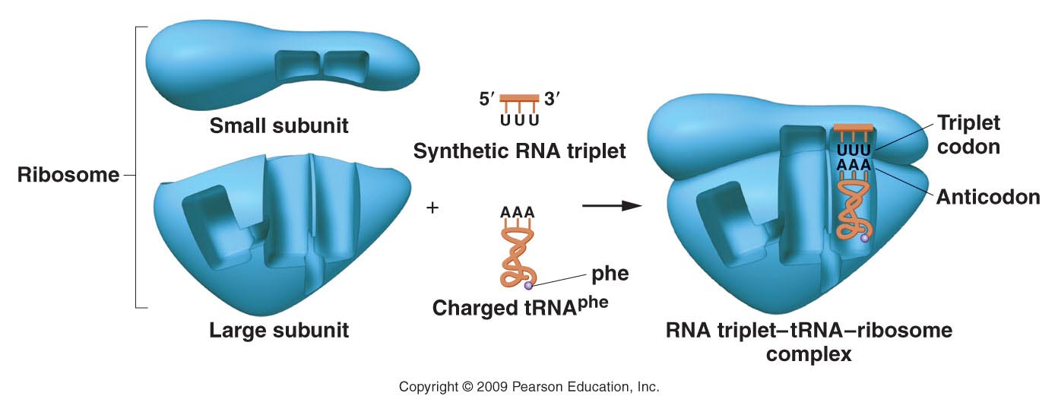
Translation occurs on/within ribosomes
Codon in the mRNA
anticodon in the tRNA
Figure 14.5
Figure 14-5 Copyright © 2006 Pearson Prentice Hall, Inc.
Notes:
20
Figure 14-5 An example of the triplet-binding assay. The UUU triplet acts as a codon, attracting the complementary tRNAphe anticodon AAA.

Slide 21
Watch, review, explain, sketch…
Go to animation
https://www.dnalc.org/view/15481-Translation-RNA-to-protein-3D-animation-with-no-audio.html (Simpler--no voice)
https://www.dnalc.org/view/16933-3D-Animation-of-DNA-to-RNA-to-Protein.html (Includes mRNA splicing---with voice)

Slide 22
Practice decoding a gene
Start with DNA
Translate to RNA
Find the start codon (establish a reading frame)
Begin decoding/translation according to the universal code. End when you reach a stop codon…if the gene is completely represented...

Slide 23
Recall the central dogma…
  Ultimately a gene will encode a protein that will directly or indirectly influence a phenotype. Practice putting the details of gene expression into context with Mendel’s observations!
  What is the molecular explanation for smooth and wrinkled peas or A blood type or Tay-Sachs disease...? Practice thinking/writing this out---from Mendel’s definition of dominant and recessive traits to the exact reason that one pea may be smooth and another wrinkled…or

Slide 24
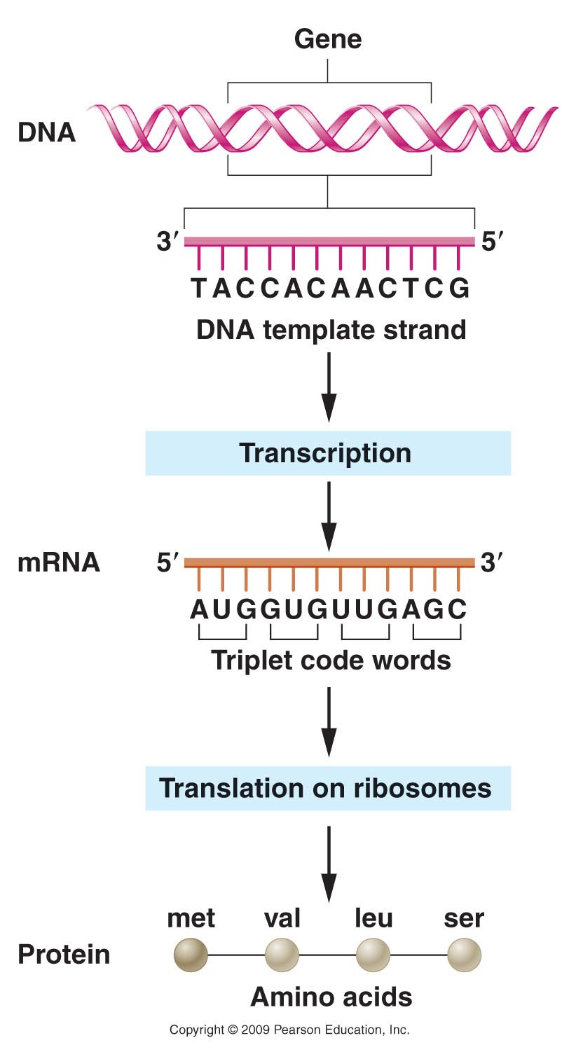
trait/phenotype
Figure 14.1
Notes:
24
Figure 14-1 Flow of genetic information encoded in DNA to messenger RNA to protein.

Slide 25
Different forms of the protein will affect some characteristic of the organism.
The gene may have different forms (alleles)
The alleles will likely have different nucleotide sequence
The proteins will likely have different amino acid sequence
trait/phenotype
Figure 14.1
Notes:
25
Figure 14-1 Flow of genetic information encoded in DNA to messenger RNA to protein.

Slide 26
Will all nucleotide changes (mutation/creation of alleles) alter the phenotype?
No…2 reasons
  1. Redundancy of the code—a change in codon may NOT change the designated amino acid.
  2. Some mutations make conservative changes in the protein.
    One amino acid is changed to a very similar amino acid.

Slide 27
However…
Some nucleotide changes (mutation/creation of alleles) result in major changes in the phenotype.
Any change which alters the amino acid(s) significantly ( large deletions, insertions, or any change to an aa with different properties)

Slide 28
Chapter 15
What is the source of different alleles? Mutation!
Mutation definition---an alteration in DNA sequence.
This can be in many forms and refers to changes anywhere in DNA, but we will focus on coding regions of genes.

Slide 29
Point mutation
A point mutation is the substitution of a single nucleotide in a DNA sequence.
ATTTGCCACATAGGCAAAC
ATTTGCCCCATAGGCAAAC

Slide 30
What’s the result?
It depends on where the mutation is and how it might change the mRNA code.
1. A silent mutation does not change the amino acid because of code degeneracy.
2. A nonsense mutation creates a stop codon instead of an amino acid codon and results in translation of a truncated (shortened) protein
3. A missense mutation changes one codon to another codon—other than a stop codon

Slide 31
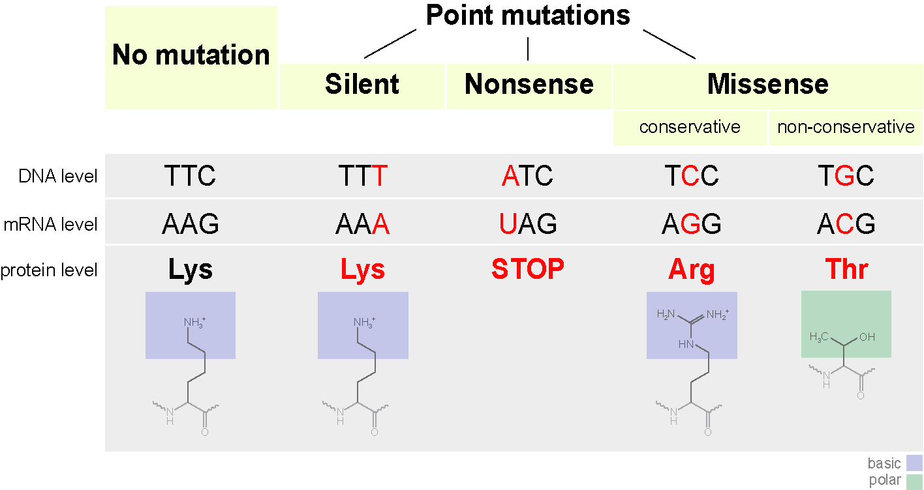
Allele 1 (Wild type allele)
New/different alleles

Slide 32
A missense mutation that changes an amino acid to a similar amino acid is called conservative, and may not affect the folding of the protein, and thus its function may not be changed.
A missense mutation that changes an amino acid to an amino acid with really different characteristics is called non-conservative, and will likely greatly change/destroy the folding of the protein, and thus its function.

Slide 33
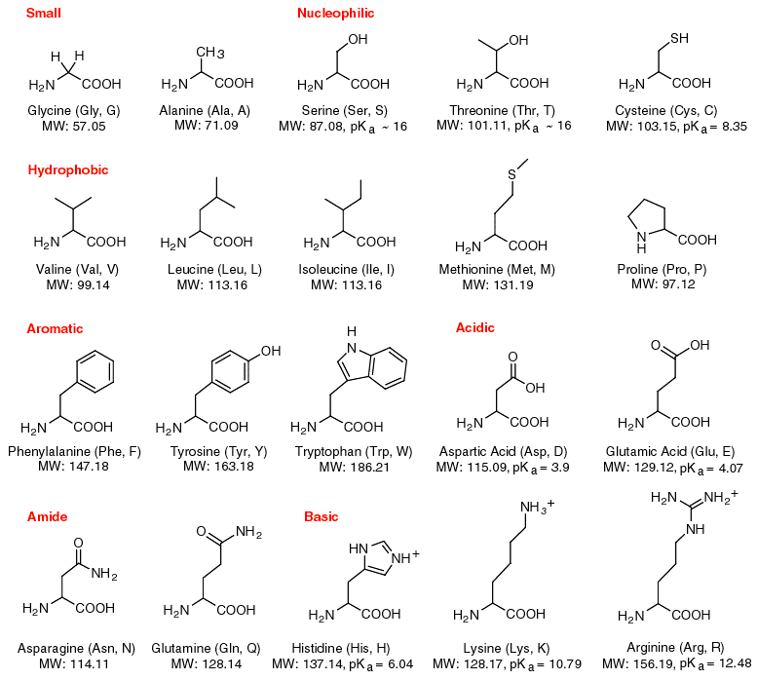
List of the 20 amino acids.
Example---
A conservative substitution would change one acidic amino acid for another acidic one…
A non-conservative substitution would change an acidic amino acid to a basic one...

Slide 34
Conservative mutations change the DNA of the coding region, and the amino acid sequence of the protein, but the protein still functions normally.
  These are sometimes called neutral mutations. (Don’t confuse with silent mutations)

Slide 35
Other types of mutations
Insertions
Deletions
(See next slide)
Inversions
AACTCAGGGCTATAGCT
AACTCCGGGATATAGCT

Slide 36
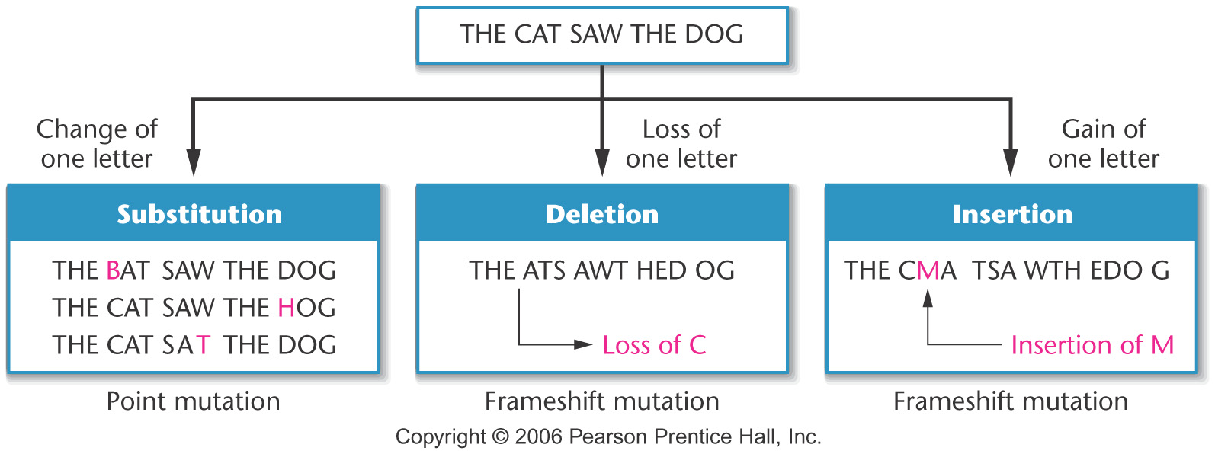
substitutions vs. insertions/deletions
Figure 15-1 Copyright © 2006 Pearson Prentice Hall, Inc.
Notes:
Figure 15-1 Analogy of the effects of substitution, deletion, and insertion of one letter in a sentence composed of three-letter words, demonstrating point and frameshift mutations.

Slide 37
Note how point mutations/substitutions, have a local effect. The “sentence” is only changed in one word. The mRNA changes in only one codon—at most affecting one amino acid.
Insertions and deletions have a much more extensive effect. They change the reading frame of the coding region. ALL codons are affected from the point of insertion or deletion.

Slide 38
These mutations are called frame-shift mutations. They always alter the protein encoded by the gene, often by the introduction of a stop codon somewhere within the coding region.
Even if a full-length protein is produced, it will have no resemblance to the normal protein and will not function in its normal role.

Slide 39
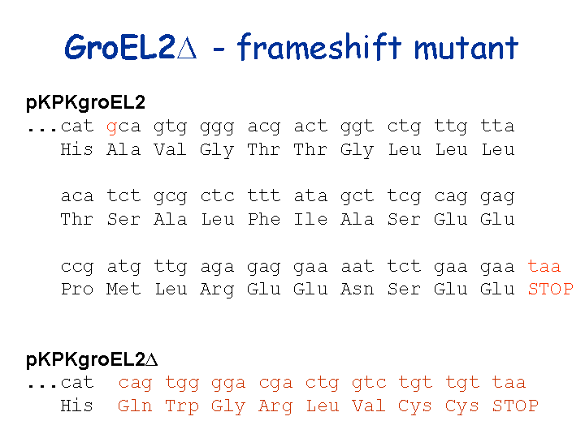
Example…deletion of g in first line.
Triangle means deletion

